Slide 1

Introduction to GitHub: how to use it, and why it will improve your coding life
Cam Nugent
CNuge
R Users Group
January 26th

Slide 2

What is GitHub?
A web based file hosting service, with version control
And it has a fun logo

Slide 3
What is Version Control?
You can see differences between versions
What is added and what is taken away
You can ‘roll back’ to previous versions when you break stuff
Two people can safely work on the same file
Can’t accidentally save over other peoples changes

Slide 4

So what is GitHub good for?
Storing your code
Like a fancy dropbox
Sharing your code
Refer people to exactly what you did (repeatability)
Help others solve problems you’ve already solved
Fork a repository
Showing off your code
Interviewers look at it
Some jobs even ask for it on applications!

Slide 5

So what is GitHub good for?
Group work
People can commit to same file
Keeps track of versions and changes for you
Don’t need to take turns
Positive feedback
People can like your stuff
Give back (to R libraries)
Make developers aware of bugs
Good way to get noticed
Contribute to important libraries in your field

Slide 6

!=
Github == website
Git == version control system
Github uses the commands from git to keep track of files and store them on the website
Like the relationship between Rstudio and R

Slide 7
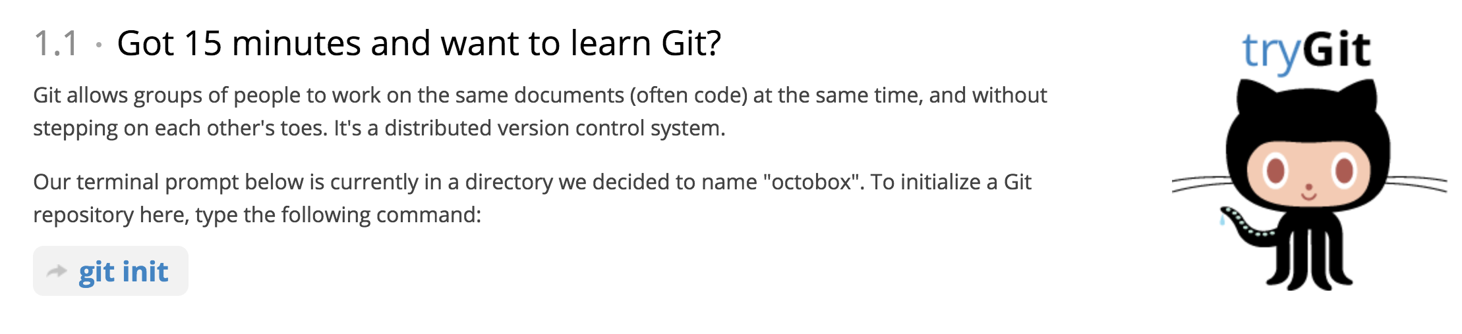
Ugh now you’re going to tell me I need to learn a bunch of code aren’t you?
No I’m not!
If you’re a big command line fan here is the tutorial on how to use git that way… go nuts:
https://try.github.io
15 minutes is a bold claim… I found it takes a lot longer to master

Slide 8


For everyone else…
A Graphical User Interface for GitHub
desktop.github.com/
Works for Mac, PC and Linux
You can use it effectively
without being a master!

Slide 9

A tour of using GitHub Desktop
How to do the following:
Make a repository/folder (init)
Change the file (commit)
Observe the changes (diff)
Undo changes (revert)
Fork other people’s code (fork)
Suggest changes to other people’s code (Submit a pull request)

Slide 10
In summary
GitHub and the Desktop interface we explored today can be useful in many ways
For people of all skill levels
I’d like to propose an UGRU GitHub Repository
A place for:
Sharing code from weekly presentations
Help requests
Follow up exercises/Collaborations
I’m lonely :’(

Slide 11
Follow Up Resources
Trending R github repositories: https://github.com/trending/r
Free GitHub additions – education pack:
*The private repositories perk is 10/10 if you’re shy
https://education.github.com/pack
Cam’s Blog post on making a pro looking GitHub Repository (warning no R in sight)

Slide 12
People to follow
Tidyverse BDFL: github.com/hadley
People in the department:
Kevin Cazelles: github.com/KevCaz
Karl: github.com/karl-cottenie
CGG: github.com/cgreysongaito
Tim Bartley: github.com/bartleyt
Matt Brachmann: github.com/PhDMattyB
Me: github.com/CNuge

